Slide 1
The Dust of Our Great Capital: urban implosion and Derek Raymond’s ‘Factory Quartet’
Dr Gareth Millington (University of York)

Slide 2
Presently I got out my flashlight and shone it over her, because the place where she had collapsed and died between the beds was so dark, and the old white light-shade overhead, thick with dust, was wrongly placed to shed enough light on her. In the glare of the torchlight her indifferent eyes glittered coldly past me. On these eyes, the dust of our great capital was already beginning to settle.
(I Was Dora Suarez, p. 43)
Notes:
Demise of Dora, wracked with AIDS and brutally murdered; demise of the city
This paper is concerned with the ‘morbid space’ created by noir fiction author Derek Raymond in a quartet of detective novels written about an unnamed detective in the metropolitan police. Primarily the paper is about urban history and London’s transition from one kind of city to another. The aim is not to construct a theory of detective fiction, can look elsewhere for that, but to provide an analysis of how four crime novels reveal a unique imaginary of London at a critical point in the city’s history (a phase that may be seen as an end and a beginning, or the darkness before dawn).
This analysis is premised upon the notion that literary virtualisations of actual space can—through the fantasies and dreams they disclose—be productive of new theories of urban space (AlSayyad 2006; see also Diken and Laustsen 2008). Such fantasies are part of the reality of the city; they are a component after all of urban consciousness, urban subjectivity. As Richard Lehan explains, there is a dialectical relationship in operation where literature gave imaginative reality to the city while urban changes transform the literary text. This shared textuality—this symbiosis between literary and urban text—is the methodological basis for this paper.

Slide 3
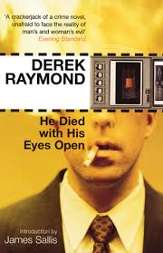
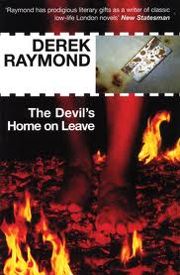
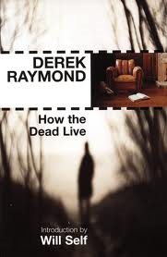
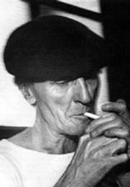
Notes:
Derek Raymond (real name Robin Cook) was born in 1931 into a wealthy family. He grew up in London and was educated at Eton during and just after WWII. However, he hated Eton—he once said the only person who hated it more than me was Orwell—and aged 16 he dropped out and embarked on a very different kind of life to that envisaged by his parents, drifting to Spain for four years and travelling to America before returning to London. During the late 1950s and early 1960s he was embroiled in the London underworld, running five companies for conman Charles Da Silva. He later became a mini-cab driver and abattoir assistant. These experiences ended up in his books written as Robin Cook, which includes The Crust on its Uppers (1962) and A State of Denmark (1970), books that focused on the life of London villains. Raymond escaped to France during the 1970s and 1980s and it was in the later decade that he embarked on the Factory novels based around the activities of an unnamed tough-talking and cynical detective sergeant at the Met Police’s Department for Unexplained Deaths. The factory was the name used by both the police and villains for the police station in Poland Street where the detective is based. The quartet comprises He Died With His Eyes Open (1984) (recent Radio 4 adaptation), The Devil’s Home on Leave (1985), How the Dead Live (1986) and I Was Dora Suarez (1990). It is these novels that earned Raymond the reputation of the pioneer of British noir, a writer who anticipates the madness of later writers such as James Ellroy and David Peace. The factory novels were fairly recently reissued by the publisher Serpents Tail. Raymond’s literary memoir, entitled The Hidden Files was published in 1992. Raymond died in London in 1994, shortly after he returned to the city, taking up residence in the Coach and Horses pub on Greek Street.
My analysis is based upon these five books.

Slide 4
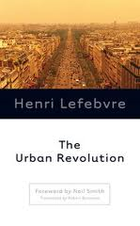
‘How can we make the transition from the city, which maintains its image, which has a heart, a face, a “soul”, to urban society, without a long period of disorientation?’ (Lefebvre, 2003: 183 original emphasis).
Notes:
It is suggested here that Raymond’s factory quartet explores the subjective possibilities of an historical moment, what Lefebvre (2003) refers to as the ‘critical phase’ of the implosion-explosion of the industrial city. In short, Lefebvre views the industrial city as being superseded by urban society, by widespread urbanization, by what is referred to today as planetary urbanization. Urban society is not constructed on the ruins of the classical city; indeed in the West the city fragments (ibid: 169). Existing urban centres implode, since they cannot contain everything, their historic residential spaces crumbling, in the process of being replaced by offices, consumption spaces, and of course, the bourgeoisies and middle classes. Great urban centres such as Paris—or London—become centres of power and wealth (ibid: 170), monuments to the emerging global economy. Raymond’s novels offer a rare subjective glimpse into the imploding city during this period. The structural changes that London underwent from the late 1970s onwards have been well observed (see for example Sassen, 2000), and there now exist many accounts of the urban explosion that followed (see work of Neil Brenner among others) but Raymond’s rendition of central London during the early/mid 1980s as a morbid space provides a fascinating, yet disturbing document of the process of implosion and the imaginaries it inspires. The novels address, though they do not answer, the central question of Lefebvre’s book The Urban Revolution which is:
‘How can we make the transition from the city, which maintains its image, which has a heart, a face, a “soul”, to urban society, without a long period of disorientation?’ (Lefebvre, 2003: 183 original emphasis).
In his autobiography, Raymond explains how his detective novels intervene as a being approaches their final moments, he comments how, ‘The first night of death must seem so strange’ (Raymond, 1992: 144 original emphasis). The factory quartet evokes the disquiet of this first night. As well as the cast of murder victims dealt with by the Met Police’s Department for Unexplained Deaths, it is clearly also London’s first night that Raymond seeks to connect with.
(1) Introduction
(2) The detective novel and critical theory
(3) Raymond’s ‘black novel’
(4) Writing London
(5) The Factory Quartet: mourning the heart, face and soul of the city
(6) Conclusion

Slide 5
The Detective Novel and Critical Theory
Benjamin, Kracauer, Bloch, Mandel
Noir fiction
Derek Raymond’s ‘black novel’
‘Suarez was my atonement for fifty years’ indifference to the miserable state of this world; it was a terrible journey through my own guilt, and through the guilt of others’ (Hidden Files, p. 99)
Notes:
Detective fiction has received a great deal of critical attention, arguably disproportionately more than most popular cultural forms. Critical theorists such as Benjamin, Kracauer and Bloch were avid readers of the genre and at various points in their work referred to detective fiction, either explicitly or in more coded, metaphorical form.
Fundamentally, Benjamin views the crime novel as a phantasmagoric description of the city that has roots in the 19th century. For Benjamin, the literary genre of the detective story snoops into the dark side of the city, depicting it as a place of anxiety and danger. The city becomes ‘strange’ or unhomely: every bed is ‘hazardous’. According to Benjamin, in the detective novel, the crowd is transformed from being a harmless and amusing spectacle into an ‘asylum for the reprobate and the proscript’. This makes the city such as good place to hide. The fear of losing traces of oneself is one of the most documented aspects of metropolitan modernity (see Simmel most famously). So, the ‘detective’s work can therefore also be read as a reassuring rescue of individual traces from the anonymity of the masses’ (ibid: 172).
Kracauer: In the detective novel formal reason resolves the chaos of the moment; it solves this problem here (ibid). The detective re-connects a series of ‘banal facts’, a ‘formal tension is resolved without touching reality’ (ibid: 13 emphasis added). The lack of critical intention in the detective novel lies here. The world is apprehended only through its phenomenal forms, yet the reason why these forms appear in the chaotic way that they do is never revealed.
Bloch: There are he argues, utopian murmurs and rumblings in detective novels that can be seen in their attempts to measure the distance we have yet to go to achieve happiness. The crime novel begins with something uncanny, an unrepresentable occurrence. Bloch calls this the ‘problem of the omitted beginning’ (1996: 263). The novel that follows is then concerned with exposing evidence of the past that can be productive for the future. The detective novel is about exposing false illusions, it is deeply suspicious of ‘draperies and facades’ (ibid: 253), but more than anything it is about the process of uncovering truth rather than the bare facts of ‘truth’ itself
Mandel: detective fiction is concerned with the bourgeois need to defend social order.
And yet especially when one considers the noir fiction that emerged from so-called ‘hard-boiled’ authors in the US from the 1920s onwards (Chandler, Hammett, McCoy and later, Goodis, Himes, Ellroy), detective novels may not be so easily reduced to bourgeois ideology, or as concerned only with the banalities of life. As Duncan (2000: 7) explains, ‘[n]oir doesn’t always have pat solutions and attractive people, doesn’t spoon-feed safe fantasies into drooling mouths. Noir drags you screaming and kicking though all sorts of hell before reaching an unsatisfactory ending’ (emphasis added). In noir there is little redemption on offer; there are no happy endings.
Noir detective fiction is often ‘beyond politics’ in the sense that it is thoroughly pessimistic regarding any governmental ‘solution’ to crime via social policy or policing techniques. Human depravity is greater, deeper, and more historical than any ‘quick fix’ could hope to rectify. This is just one sense in which writers and critics such as James Sallis have argued that noir stories exist to ‘unfold the lies society tells is and the lies we tell ourselves’ (cited in Horsely, 2001: 9).
Dimendberg/ Farish- usefulness of noir in urban history
In Raymond’s (1992) autobiography ‘The Hidden Files’ he explains by what he means by the ‘black novel’, and he is referring here explicitly to his factory novels that star the unnamed detective. The first thing to understand, according to Raymond, is that black literature exists because horror exists. The black novel is metaphysical and blurs boundaries between self and other; beauty and sadness; offender, detective, victim and writer; inanimate and inanimate objects. Raymond is attracted to alienated forms of consciousness they mirror his own sense of desolation (ibid: 338). For example, in discussing his writing of the bleakest factory novel, I Was Dora Suarez, Raymond explains how the book plunged him into evil and ‘became the cause of my seeking to purge what was evil in myself’ (ibid: 99). Moreover, ‘Suarez was my atonement for fifty years’ indifference to the miserable state of this world; it was a terrible journey through my own guilt, and through the guilt of others’ (ibid). The writer of the black novel becomes the room, the street, the situation (ibid: 150). Fundamentally, the black novel describes ‘men and women whom circumstances have pushed too far, people whom existence has bent and deformed.
The black novel is a serious endeavour and sets itself against mass-market crime or detective novels. Its objective is not to escape, but to banish escapism and ‘to take people into the vile psychic weather outside their front doors’ (ibid). For Raymond (ibid: 98) the black novel exists to show people what true despair is, those ‘small, dark, isolated rooms of existence with every exit barred, bricked up’. Black writing is the recognition of despair in others (ibid: 190). This is perhaps one of the reasons why Raymond’s detective remains nameless. He is not important; he is simply ‘everybody who has ever looked down over the edge into a void with the awareness that justice is absent’ (ibid: 214). Thus the problem of the black novel is stark, ‘can a detective really establish credible contact with a dead victim in a shabby room?’

Slide 6
Writing London in the 1980s
In practice the urban core (an essential part of the image and the concept of the city) splits open and yet maintains itself: overrun, often deteriorated, sometimes rotting, the urban core does not disappear […] And yet its reign seems to be ending. Unless it asserts itself again even more strongly as a centre of power… (Lefebvre, 1996: 74)
Notes:
One of the reasons Raymond’s factory novels are so fascinating is that they offer a portrayal of London in the early to mid-1980s. They capture what Joe Kerr (2012: 29) calls the ‘general atmosphere of slow decline’ that pervaded the metropolis at this time. This period was characterised by a discourse of the ‘crisis of the inner cities’, which is in part the crisis of the post-war welfare statement. This period is also critical to London’s history because it represents the ‘darkness before the dawn’, with London’s ‘dawn’ being the ‘Big Bang’ of 1986 that opened up the financial markets and did so much to allow the City of London to compete with Wall Street in becoming command centre of the globalised economy. Brenner calls ‘global city formation and state re-scaling’
Although the boom of the late 1980s (that extended but for a minor interruption in the 1990s into the 2000s) was only a matter of years away when the factory novels were written, an alternative future for London other than continued despair and deterioration barely seems possible. Raymond’s London is a shadow of its former social and architectural glories, yet of course it is this shadow’s power to darken the whole city that fascinates Raymond. It is the negative possibilities of the historical urban moment, decay leading to death, which Raymond wishes to explore (at the expense of ‘optimistic’ scenarios or imaginaries less mired in post-colonial melancholia—there is plenty of this in the novels!).
Raymond’s description chimes with many academic sources of the time, taken mainly from urban studies (broadly conceived) although his register is vastly different, veiling his descriptions of urban decay with a distinctive noir aesthetic.
Two academic examples book end the period covered by the factory novels. First is SSRC Inner Cities Working Party’s report of 1981, titled ‘The Inner City in Context’ and edited by Peter Hall. The objective of the volume was to elucidate the problem of the inner city in its ‘temporal, spatial, socio-economic, and policy context’. Hall’s introduction explains that the inner city problem is the convergence of several problems that include demographic and industrial decline, concentrated poverty and deprivation (Hall et al. 1981: 1). Second, is Patrick Wright’s (1991) ‘A Journey Through Ruins: The Last Days of London’. This book was published at the very end of the 1980s and takes stock of London’s transformation during the Thatcher years although in its excavation of 1980s London—focusing in particular on the East End—the book investigates wider historical themes such as the rise and fall the council tower block, privatisation, World War II commemoration ceremonies and the signs that gentrification had finally moved East. As Wright (ibid: ix) explains in a preface to the 2009 reprint, ‘the London that was dying was the city of planning and the welfare state born of the post-war settlement’. For Wright this fall was partly the result of administrative incompetence and corruption, yet it was also caused by the free-market ideology of Margaret Thatcher’s government.
Of course, as I stated in my introduction, the significance of what was happening to London was actually far greater than most urban academics could grasp at the time. In terms of the depth of Raymond’s writing I feel that perhaps he conveys the social and psychic implications of the emptying of the urban centre more acutely than scholarly accounts. He captures the violence of the splitting open, the deterioration and the rotting that is present in Lefebvre’s notion of implosion:
In practice the urban core (an essential part of the image and the concept of the city) splits open and yet maintains itself: overrun, often deteriorated, sometimes rotting, the urban core does not disappear […] And yet its reign seems to be ending. Unless it asserts itself again even more strongly as a centre of power… (Lefebvre 1996: 74)
The ancient city (which was modified in early modernity) is now broken apart for good and remade as a centre of decision-making and commerce, a centre of power. The city is turned over to urbanists, or technocrats, who view the city as a problem to be solved. Lefebvre argues this creates a growing poverty of daily life as people (inhabitants) have no choice but exist in an increasingly homogenous space, full of instructions and signals, where exchange value dominates (economic rationalism) and qualitative difference between neighbourhoods, between residents, matters less and less. Such existence, for Lefebvre, is a recipe for ‘contempt, mental and social misery’ (ibid: 128). These are the symptoms of an historical ‘tendency towards destruction of the city, as well as a tendency towards the intensification of the urban and the urban problematic’ (ibid: 129). The factory novels illuminate and explore the possibilities of the first part of this inherent contradiction.

Slide 7
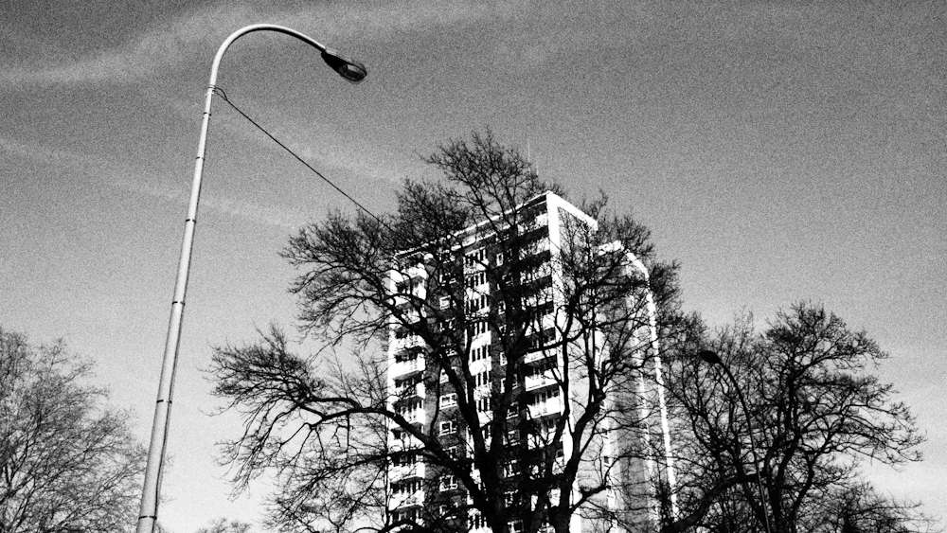
I went over to the window and looked out. It was four in the afternoon. Opposite, six eleven-floor blocks stood about in the unimaginative attitudes of those who had conceived them, on a piece of wasteground. Far away, across the river to the north, what was left of London these days tried to look cultured and inviting. It failed—anyway, with me.
(Devil’s Home, p. 76)
Notes:
Analysis of the novels: how they inhabit this moment of urban history (yet bend it out of shape) Derek Raymond’s factory quartet offer deep meditations into a dark moment in London’s history; the novels document the despair of a city that appeared on the verge of erasure; its continued tired existence principally operating through aura and monuments.
From a killer’s tower block in Catford, SE London
Sense of London’s demise, all pervading gloom; Nostalgia, despair, pro-urban, anti-urbanist (segregation, planning, slum clearance leading to blight—still ongoing in the 1980s; likely to be gentrified today) anti-planning, conformity, society of bureaucratically controlled consumption, themes that are repeated)

Slide 8
Sickening errors, democratically arrived at of course, lay either side of the road as I drove west out of London. Blocks of semi-abandoned streets made dead ends of effort where people who had tried to start something—anything—had been crushed by the dull, triumphant logic of the state. I crossed the demarcation lines of two ethnic groups at Swallowtail Lane; the Regal cinema loomed in my lights, its façade blackened by fire. […] The blindness to understanding was equally lit by the few lights that swayed in the icy darkness, and by the rows of windows, some half lit, in small streets that no longer led anywhere but to danger. The windows all had that same mail-order leer that made a flat, to its family, whatever its colour seem falsely safe, and each was whitened by the eyeball of a Japanese lampshade. […] In further sad, narrow streets, beyond my car lights, half hidden by groups of old bangers with their front wheels up on the pavement, lay ruined three-storey houses that the council neither had the money to restore, nor corruption interest in pulling down. These were all dark—the power, the water cut off in them, life itself cut off there at this wrong end of winter. Yet life did cling on in them, I know.
(How the Dead, p, 24-5)
Notes:
Similar perspective on London

Slide 9
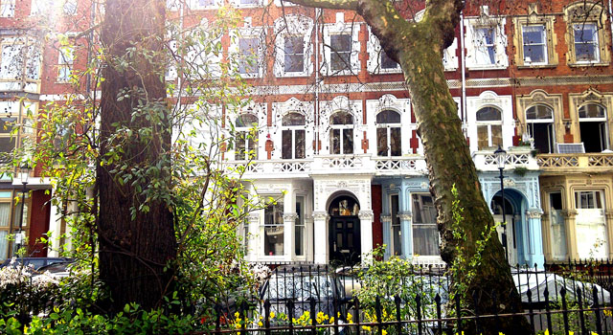
‘I became a part of everyone present in that miserable corner of hell, and they of me […] I still can’t get Dora out of my mind […] I close my eyes and see her arm stretched out to the axe again in an attempt to reason with her killer through the desperate gasps of her breathing; I hear her last protracted cry for the help that never comes’
(Hidden Files, p.317).
Notes:
Of course, the novels are not only about the city but the metaphysical qualities of the ‘black novel’—as expressed in the Hidden Files—allow us to consider the possibilities of author becoming one with evil, with the wronged, the lost and the city itself. Raymond explains how in writing he becomes the room, the street, and the situation. SMALLER SPACES, NOT THE WHOLE CITY AS PREVIOUS EXAMPLES In reflecting upon writing the most disturbing of the four novels—I Was Dora Suarez—he explains,

Slide 10
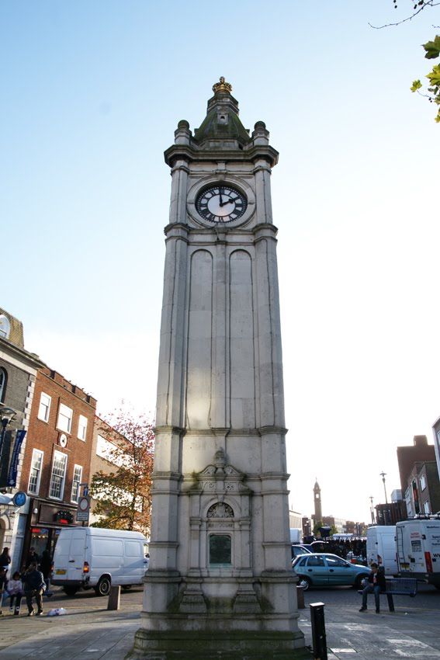
Staniland’s room was one of the most putrid I ever saw. […] Romilly Place was off the Lewisham end of the Old Kent Road near the clock-tower; the houses were three-storey tenements and filthy […] I went up the stairs quickly, but trod on the side next the wall to stop them creaking—there might just still be guests. I needn’t have worried: nothing followed me up the stairwell but a smell of garbage. The second door I came too, I sent in and shone the torch around. I was sure it was Staniland’s room […] I went to the window to open it and get some air, but it was nailed shut, so I stood in the middle of the bare linoleum floor and wondered what it must have been like, Staniland and Barbara living there together—when she was home. Home! There was the cookette in the corner by the window, just as he had described it; there, too, was the sink with the cracked mirror over where she had fixed her face nonchalantly after he had hit her with the shoe. There was the bedding on the floor where he had muttered his passion for her, and where she had lain back, flicking through the pages of Playgirl, while he drunkenly tried to force her thighs apart. I don’t believe in ghosts, but that room was thick with death, jostling me in the half dark; the dead man seemed to groan after me to avenge him. The room was in an appalling state, too. The weather was dry at the moment, otherwise I bet it rained in […] I left, hoping the council would tear down the whole of Romilly Place one day, when they stopped screaming politics at each other […]. (He Died, p. 77-8)
Notes:
Raymond is compelled to visit with obsessive purpose its seedy and menacing pubs, acerbic offices, road junctions and disused warehouses as well as the dingy bedsits and rented rooms of the city. All these sites are pitiful and sorrowful yet Raymond always renders them human places, even if the human quality is derived from tragedy. He inhabits, becomes these places by expertly detailing the materiality of place to create a powerful structure of feeling. [the narrator is, as always, the unnamed detective]
Raymond resolutely fails to acknowledge the gentrification and regeneration that was in progress by mid-1980s. He chooses to focus exclusively on the ‘breaking apart’ aspects of implosion. In this sense Raymond’s London—and just like all literary cities—is an artistic creation rather than mirror image (though Raymond maintains a fierce commitment to the real). For Raymond it is the sorry details of demise that matter. Whereas for Kracauer the facts are banal, Raymond’s facticity is used to convey the deep alienation of life in London during this period.

Slide 11
I took in the shambles of the dark, cramped Victorian hall next. There was a pervading smell of urine everywhere. A pointed old woollen hat lay under a table where the phone stood with its cable ripped out. There was blood on the hat; it must have fallen off Carstairs’s head when she hit the clock. Immediately beyond her body a narrow corridor wandered at an angle to a kitchen door kept open by a rug swollen with damp—all this back part of the flat, the hall and the kitchen, was bitterly cold. (Suarez, p.39)
Notes:
Another example; highly textured description; conveying the squalor and sorrow is so important to the author. Where people died, how they died, Restitution of dignity.
Metaphysical ambiguity: city spaces as perpetrator and victim; tormentor and tormented.
Raymond knows London well [insert quote], having grown up in the city, lived there for much of his life and having spent two years as a mini-cab driver in the mid-1970s. Mix of real and fictional spaces of London. The spaces revealed in the Factory series are summoned from this experience, from fraught early hours drives with strangers to unsettling and disgusting corners of the city. In the Hidden Files he recalls a story where he drops a man off at a block of flats in North London and is told to wait. He witnesses a light go on in one of the flats followed by female screaming coming from the same window. The screaming stops suddenly and shortly after the man returns to the taxi and asks to be taken on to Bethnal Green. Raymond is paid £100.00 for his services.
Through his unnamed detective Raymond finds a way to enter these flats after the event and reconfigure the private suffering forced on another (usually a female) and to seek justice for them.
In the novels the spaces of the city are like the territories of the psyche and Raymond is determined to explore the dark recesses of both. It is a game of dare. His aim is to pursue the evil that is a flagrant presence in the city and to defeat malevolence through a central protagonist—the unnamed detective—whose tenderness for ‘the lost’ is shown as the hope and the humanity that lies deep within us all. Raymond finds everything within himself; his writing exudes the urban consciousness of this ‘long period of disorientation’. On the pages, Raymond’s London—a representational space of fantasy and symbolism, yet as real as a block of flats—is the battleground but also the stakes.
What do we mean when we say the city is at stake? Well, this is not simply the city of buildings, of architecture. Everywhere in the factory quartet architecture—especially modern architecture—is shown to alienate, to separate good from evil, us from the other, present from the past. No, Raymond is more concerned I think with the human city, an historic yet terribly vulnerable city, a city of connections between people: between the living, certainly (segregation and urban planning are shown time and again to negate these bonds) but also between the living and the dead. Raymond wants to communicate with ‘the lost’. He writes that he deliberately peoples his books ‘with wasted folk who don’t understand why they have to go down without a cry’ (Raymond, 1992: 188). It is an impossible, and exhausting task to communicate with the dead but it is taken up in a number of ways throughout the quartet.

Slide 12
While I was waiting for Stevenson I walked away from the others to a tall window and looked out over London. Words of Dora’s poured through me:
I am too fragile; I shall never find the courage to free myself—I’m blocked, I’m dying, I can’t move […] (Suarez, p. 91-2)
Notes:
For example, in He Died, the detective comes to understand and feel empathy for the murdered Charles Staniland through a series of cassettes found in his wardrobe at Romilly Place, Lewisham. The detective listens to Staniland’s voice and through learning about his depression and alcoholism, his relationship with a damaged woman and his victimisation at the hands of a bullying psychopath in the Henry of Agincourt pub he is able to piece together the murder and seek justice for the deceased. When investigating the murder of Dora Suarez, the detective finds her diary among a few poignant personal belongings. The diary becomes a similar device whereby the dead live on and are finally be understood by someone, who is of course the sympathetic nameless detective:
While I was waiting for Stevenson I walked away from the others to a tall window and looked out over London. Words of Dora’s poured through me:
I am too fragile; I shall never find the courage to free myself—I’m blocked, I’m dying, I can’t move […] (Suarez, p. 91-2)
And so Dora’s despair becomes the detective’s despair and, ultimately, London’s.

Slide 13
‘I would never have dared let myself sink so deep into the ultimate horror of Suarez if I hadn’t believed in a force willing to help me get out the other side […] Suarez is an attempt to state that, even though hope must always be subjunctive, paradise is perhaps not lost, that there may be a place for the lost after all—that it will be there after the darkness’.
(Hidden Files, p. 317)
Notes:
Raymond both loves and hates London (he is no different to most people). He is repelled by the London—the “carve up”—that he constructs on the page. Yet it’s only in the most sorrowful spaces of the city that he finds hope; it is in these crevices that hope must be found: between the beds, under the sofas, in the decrepit wardrobes and among the discarded tapes. Hope is always channelled through the compassion of the nameless detective who is sardonic, cynical and cocky but weeps uncontrollably at Dora Suarez’s murder scene and is compelled to crouch down to kiss her battered head. It is as if for Raymond to draw hope from elsewhere is superficial. Raymond wants, in Ernst Bloch’s terms (xxxi), for the darkness to be clarified. He needs to know just what is there and how scared we should be of it. The answer of course is very scared indeed, but this is catharsis—a cleansing moment for Raymond and the city, a purge. Though shattered by the effort Raymond can sense redemption for the city (even if he does not quite believe in it).
As Raymond (1992: 317) explains,
‘I would never have dared let myself sink so deep into the ultimate horror of Suarez if I hadn’t believed in a force willing to help me get out the other side […] Suarez is an attempt to state that, even though hope must always be subjunctive, paradise is perhaps not lost, that there may be a place for the lost after all—that it will be there after the darkness’.
Not redemption in a religious sense; more to do with restitution, dignity, an end to suffering. Despite the bleak tone add horrific content of the quartet this is where their peculiar ‘warmth’ comes from. It is in their anticipation of ‘something else’.
Anticipatory Illumination
Of course, for London, something else definitely was on the horizon (as we know only too well).
How aware Raymond was of the steady gentrification of London during the 1980s we cannot be sure. We can judge that for such a sharp observer of the city it would not have passed him by completely. It is certain however that his factory novels and autobiography ignore this aspect of urban implosion, that by which the centre becomes, according to Lefebvre’s predictions, a resting place for wealth and power and a space for the practice of elite consumption. Maybe the gentrification that was occurring during this period was a safety rope to hold onto while Raymond went about exploring the blight and horror of the city. Maybe the tentative signs of upscaling that he observed in London and were omitted from the novels gave him the sense this was as ‘bad’ as things would get. The irony of course is that when accounts of urban decay such as Raymond’s enter into the realm of production they can contribute (in a meagre way admittedly) to driving down house prices, providing areas with an edgy, hip cachet that invites pioneers to sample the gritty authenticity of a neighbourhood. Moreover, Raymond’s disgust at 1980s London and the novels’ post-colonial melancholia and sometimes racialised narratives of decline can perhaps, like the film Taxi Driver did for Manhattan (see Corkin 2010), serve as an avatar of gentrification; the novels can, unintentionally, appear to will the pacifying effects of gentrification into existence. This would however be unfortunate and the comparison with Taxi Driver may be ubfair. Raymond is no authoritarian or vigilante; for him the degradation of the city does not require an armed response. He would opt instead for greater inhabitability, compassion and stronger understanding between city residents (both alive and dead).
Conclusion
Summary- addresses a core concern within urban sociology, major urban transformation (ongoing). The demise, death of the city and its historic urban centre and its displacement by an explosive urbanization.
Must assess particularity of contribution
Raymond’s factory quartet surveys the implosion of the city during the early/ mid 1980s. It provides an intense investigation of urban decay and degenerating urban consciousness. In Ernst Bloch’s terms the ‘surplus’ of Raymond’s work helps grasp the conditions and tendencies of the period the author was writing. Simply, we cannot access this urban imaginary of this period elsewhere; the ‘facts’ wont deliver this. He doesn’t construct an ‘urban pastoral’, Raymond’s London is fittingly a ‘morbid space’. Raymond clearly goes beyond himself, goes beyond ‘reality’ (he emphasises some aspects over others) but in doing so more than hints at the human facets the city lacks in this moment (and arguably will go on lacking). He perhaps anticipates what is to come.
and impact of the novels
Novels deserve to have a greater impact on our understanding of this historical urban moment, because subjective accounts of implosion/ explosion are desperately lacking; especially of the former

